Slide 1
Using Maps

Slide 2
Using Maps
The Google Maps API for Android lets you include a Google Map in your app.
You can customize the look and feel of the map, as well as the map's behavior.
For example, you can change the color of certain features to highlight them, zoom in/out, display the user's location in real time, and much more.
To use the Google Maps API, you must register your app in the Google API Console and obtain an API key.

Slide 3
GoogleMap objects
A Google Map is represented by a GoogleMap object, plus a MapFragment object or a MapView object.
The GoogleMap object allows you to programmatically interact with the map.
The MapFragment and MapView objects represent the Android view components into which the map is loaded.

Slide 4
GoogleMap objects
The GoogleMap object handles the following operations for you:
Connecting to the Google Maps service.
Downloading map imagery.
Displaying the map on the device screen.
Displaying controls such as pan and zoom.
Responding to pan and zoom gestures.

Slide 5
GoogleMap objects
You can control the behavior of maps with objects and methods of the API.
For example, GoogleMap has callback methods that respond to keystrokes and touch gestures on the map.
You can set marker icons on your map and add overlays to the map, using objects you provide to GoogleMap.
MapFragment, a subclass of the Android Fragment class, allows you to place a map in an Android fragment. The MapFragment object acts as a container for the map and provides access to the GoogleMap object.

Slide 6
Using Maps
To use Google Maps, select the Google Maps Activity template while creating the project.
Because it will already have most of the settings for using the maps in our app/code.

Slide 7
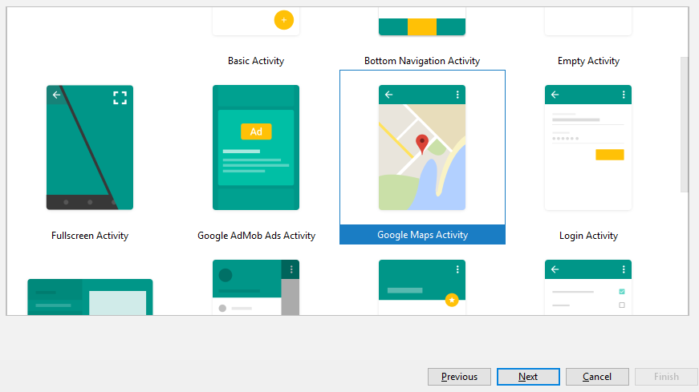
Using Maps

Slide 8
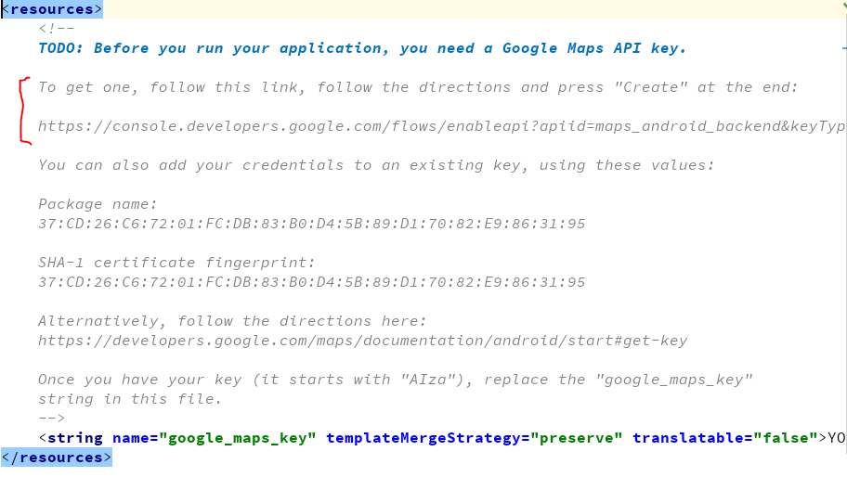
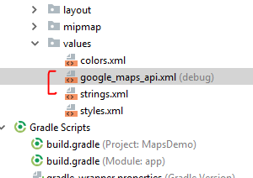
Using Maps

Slide 9
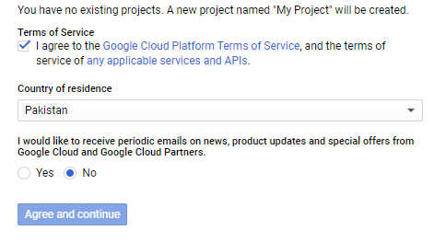
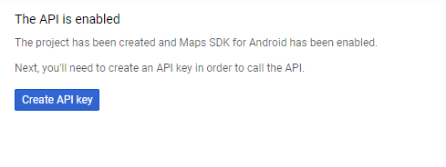
Using Maps

Slide 10
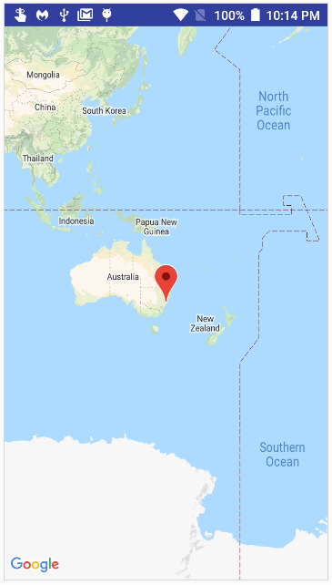
Using Maps

Slide 11
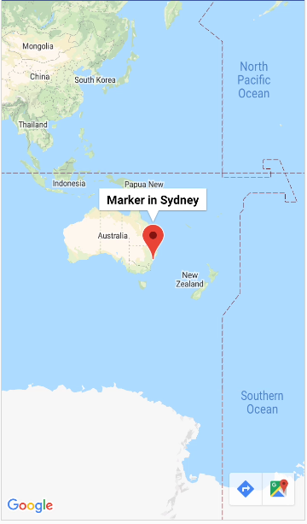
Using Maps
Tapping the marker symbol shows a small message

Slide 12
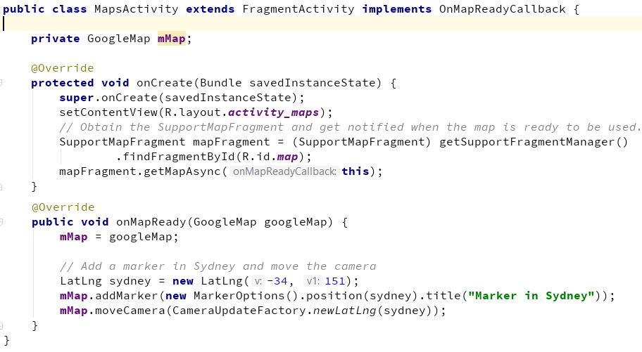
Using Maps

Slide 13
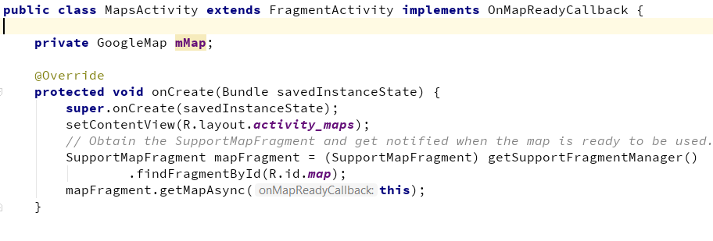
Using Maps
The method getMapAsync runs in a separate thread and gets the map in the background so that it should not block the UI.

Slide 14
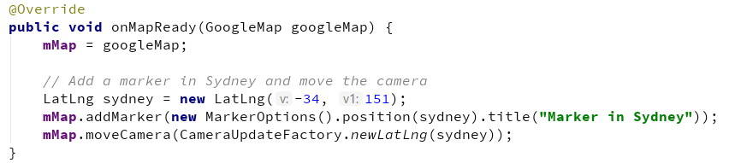
Using Maps
The code that decides where the map is centered is written in the onMapReady method. This method is called when the map is ready.
Here we set the latitude and longitude, add a marker (as shown in the previous figure, and move the camera to the location (with the provided latitude and longitude)

Slide 15
Using Maps
To set a new location, like Sukkur, put its respective latitude and longitude values.
If you do not know these values, you can get from Google Maps website by putting the location name and then copying from the resultant URL as shown below

Slide 16
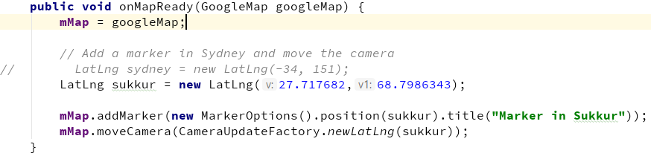
Using Maps

Slide 17
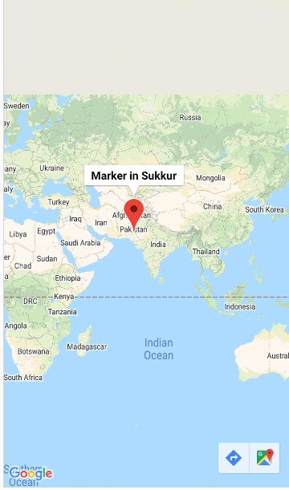
Using Maps

Slide 18
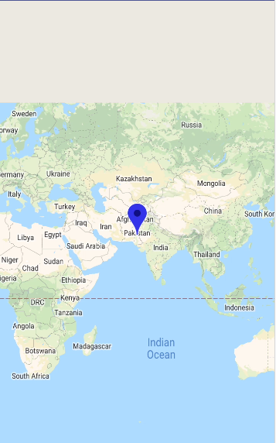
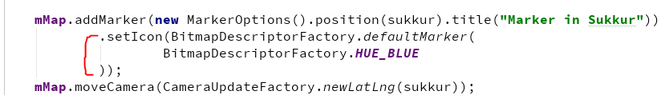
Customizing Maps – Changing marker color

Slide 19
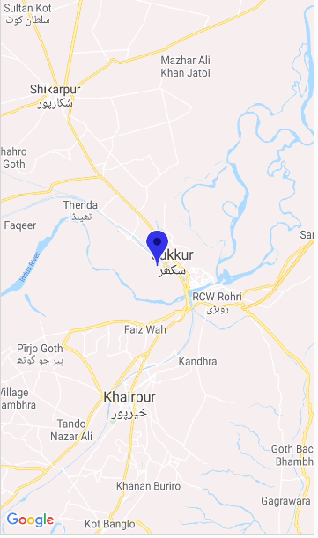
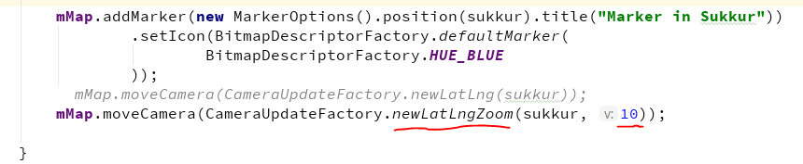
Customizing Maps – Changing zoom level

Slide 20
Customizing Maps – Changing zoom level
Zoom level argument can have a value between the range of 1 to 20.
1 means the map is completely zoomed out (world view) and 20 means fully zoomed in (street level view)

Slide 21
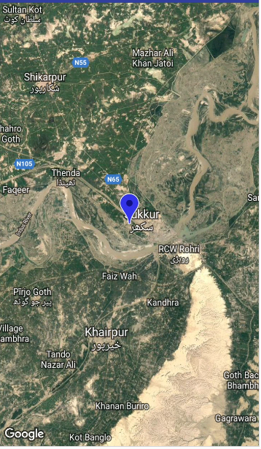
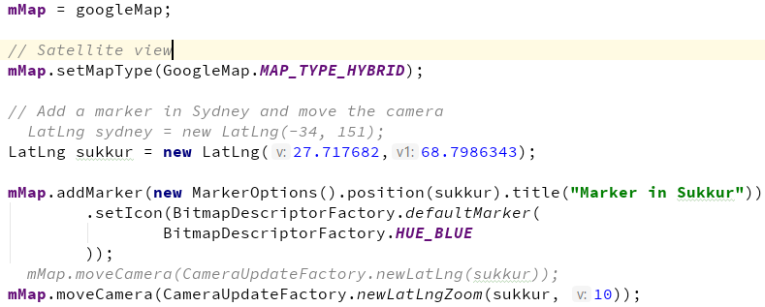
Customizing Maps – Changing map type

